Slide 1
MSA 8600 Deep Learning Analytics
Homework 3
Group 5
April 4th, 2023

Slide 2
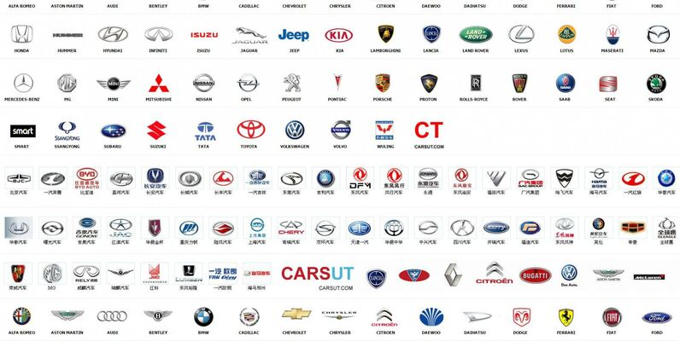
Car Brand Logo Image Classification
Team Members:
Anesia McCarthy
Jibi Jacob
Shreyashi Mukhopadhyay
Swathy Raja

Slide 3
Project Overview:
Car brand logo image classification involves the use of deep learning algorithms to analyze and identify the logos of different car brands from images. This project has extensive applications for multiple use cases including but not limited to:
Intellectual Property Protection
Marketing and Advertising Research
Competitive Analysis
Product Placement and Sponsorship
Vehicle Maintenance and Repair
Insurance Claims

Slide 4

Data Source
The data has been sourced from Kaggle.com at the following link:
Dataset Link - https://www.kaggle.com/datasets/volkandl/car-brand-logos
Data set has been harvested from search engines. It contains the images of objects containing the 8 Car brand logos.
Brand names: Toyota, Hyundai, Lexus, Skoda, Volkswagen, Mazda, Mercedes, Opel.

Slide 5
Image Counts
Train Image count
Test Image count
lexus: 301 images
hyundai: 302 images
mazda: 317 images
volkswagen: 330 images
skoda: 314 images
mercedes: 342 images
opel: 301 images
toyota: 306 images
volkswagen: 50 images
toyota: 50 images
skoda: 50 images
opel: 50 images
mercedes: 50 images
lexus: 50 images
hyundai: 50 images
mazda: 53 images

Slide 6
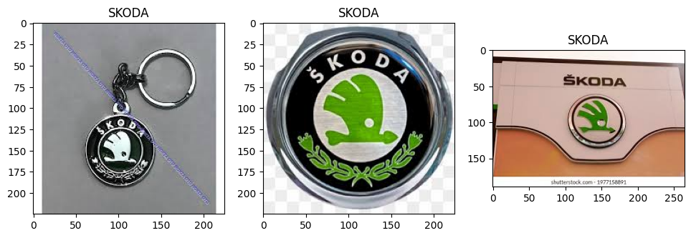
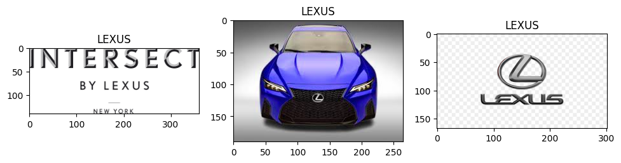
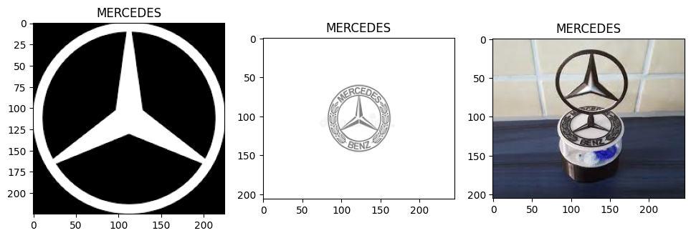
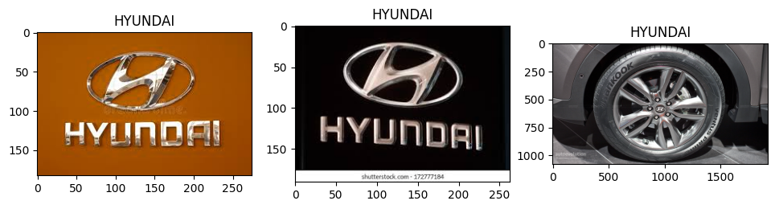
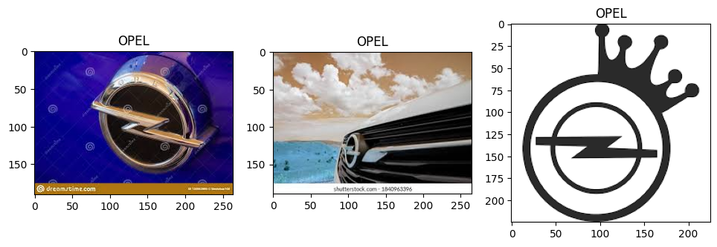
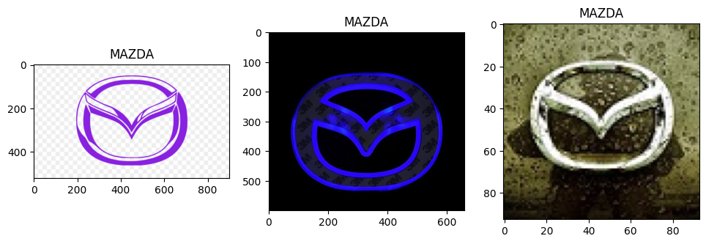
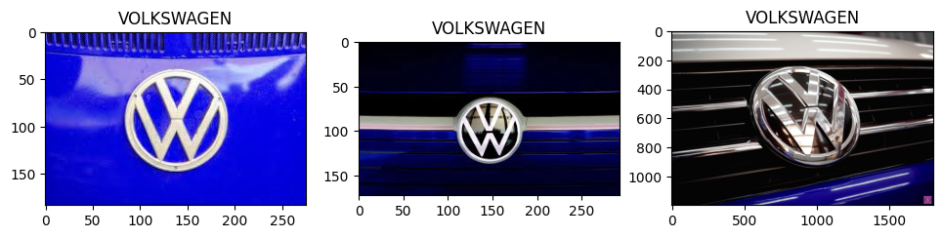
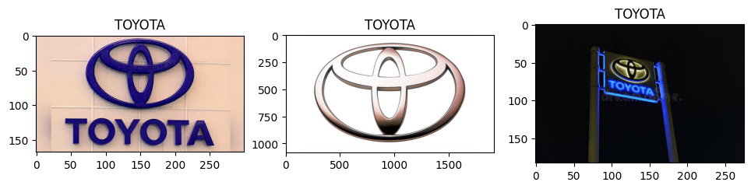
Data Visualization

Slide 7
Data pre-processing
Calculate Average height and width of all the images from Train and Test folders.
The new input image shape was passed to the models (193, 240)
The data was rescaled using Data generator with parameters rescale=1./255, rotation_range=10, horizontal_flip=True.
Data Augmentation was applied to the generated images.
Final Training dataset count: 2513 images belonging to 8 classes.
Final Testing dataset count: 403 images belonging to 8 classes.

Slide 8
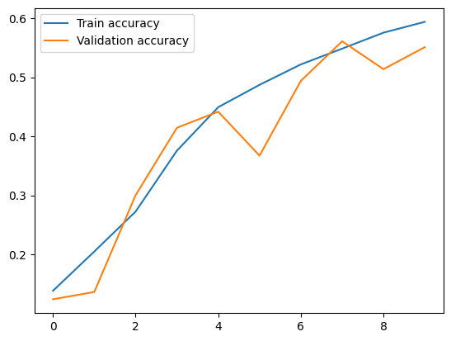
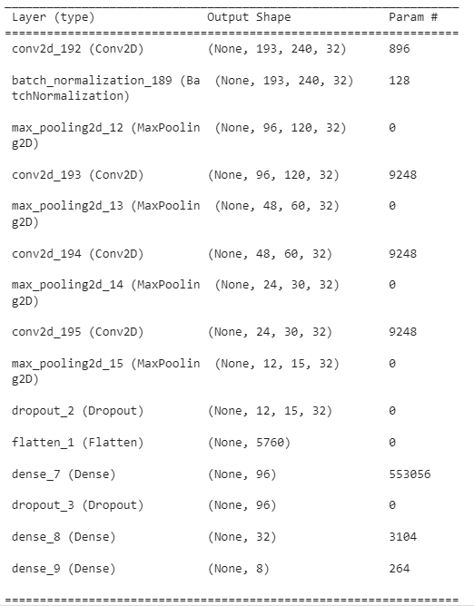
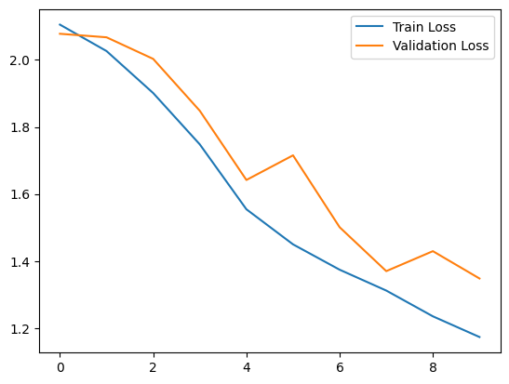
CNN Model 1: Model performance
Train Accuracy: 57.10%
Test Accuracy: 50.12%

Slide 9
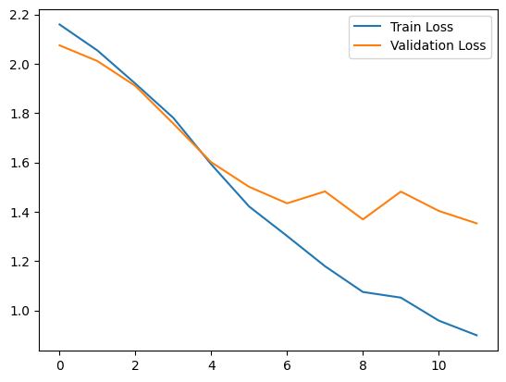
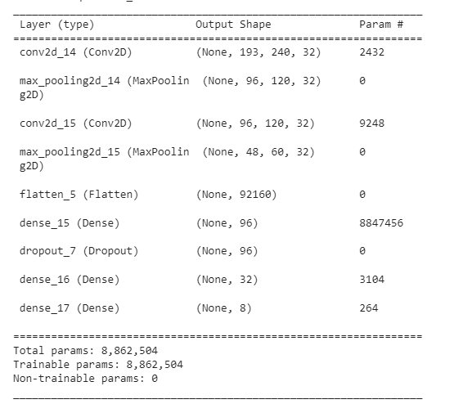
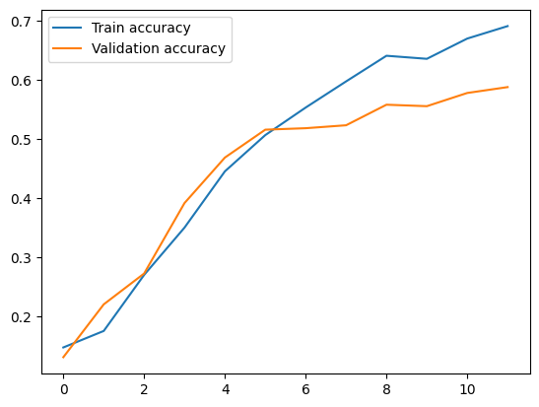
CNN Model 2: Model Performance
Train Accuracy: 72.22%
Test Accuracy: 59.80%

Slide 10
Pre-trained Models: Transfer Learning
Transfer learning is a machine learning method where a model developed for a task is reused as the starting point for a model on a second task.
We have used the following pre-trained models for our project:
VGG19
MobileNet
Resnet50
InceptionV3

Slide 11
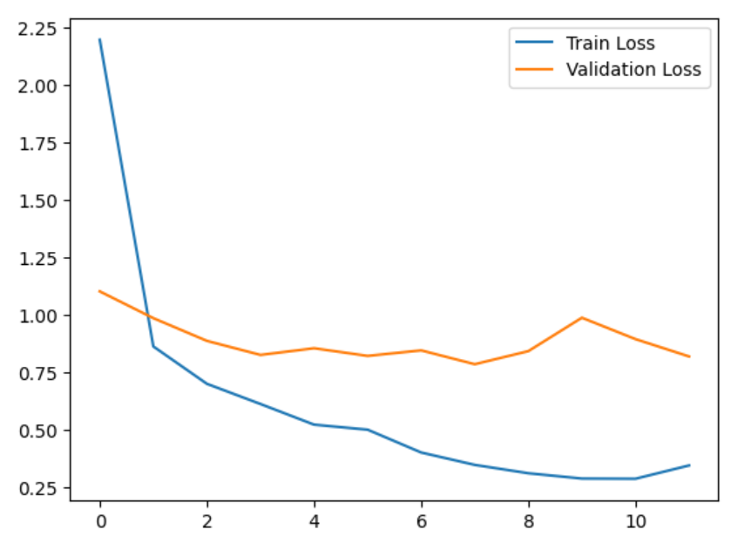
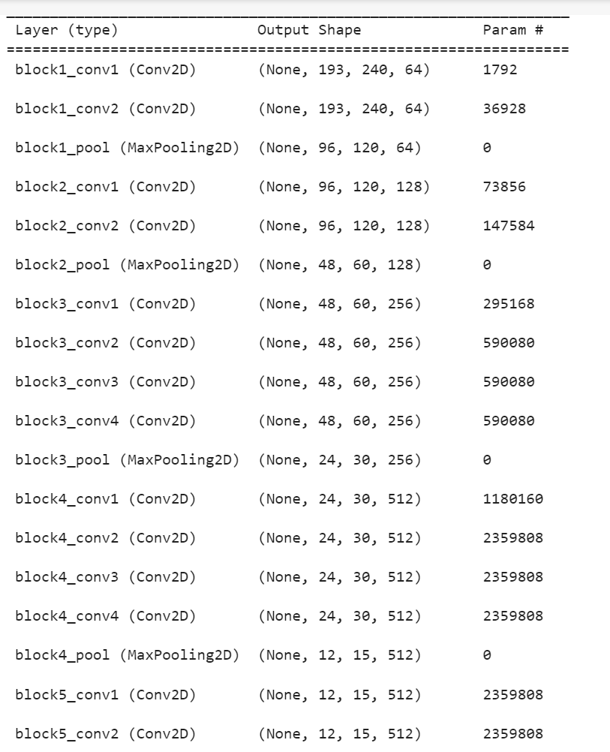
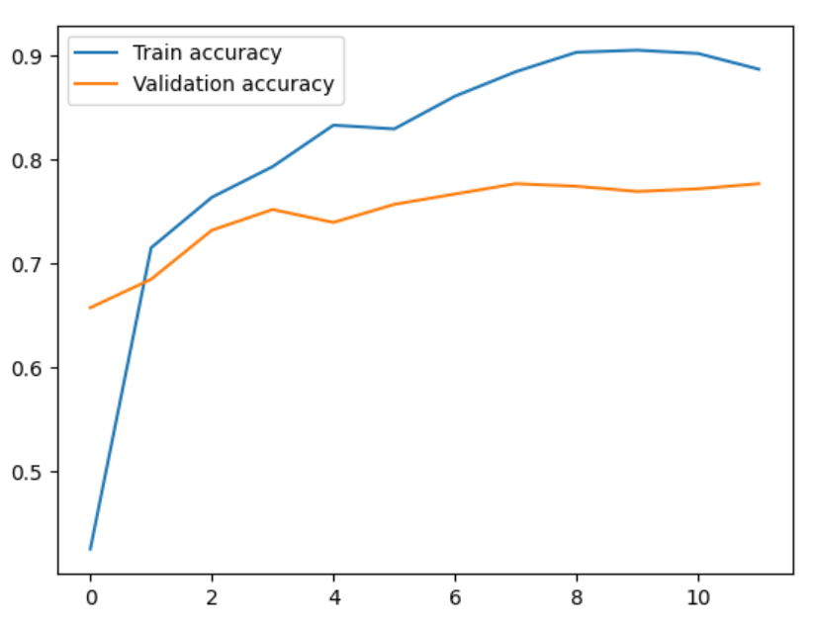
VGG19:Model Performance
Train Accuracy : 88.60%
Test Accuracy : 77.67%

Slide 12
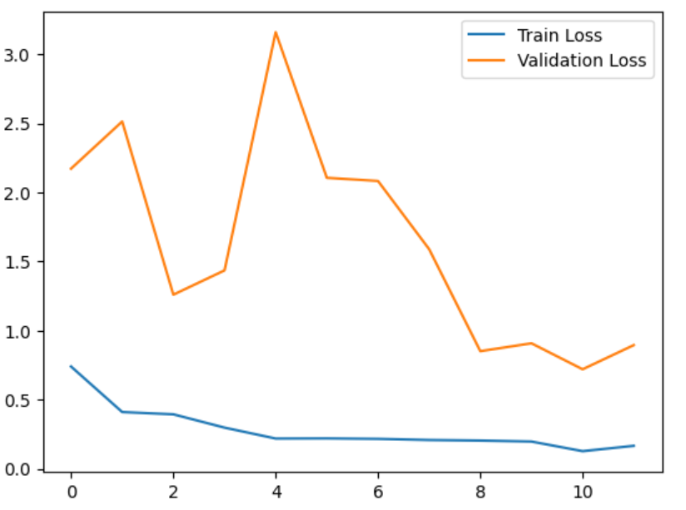
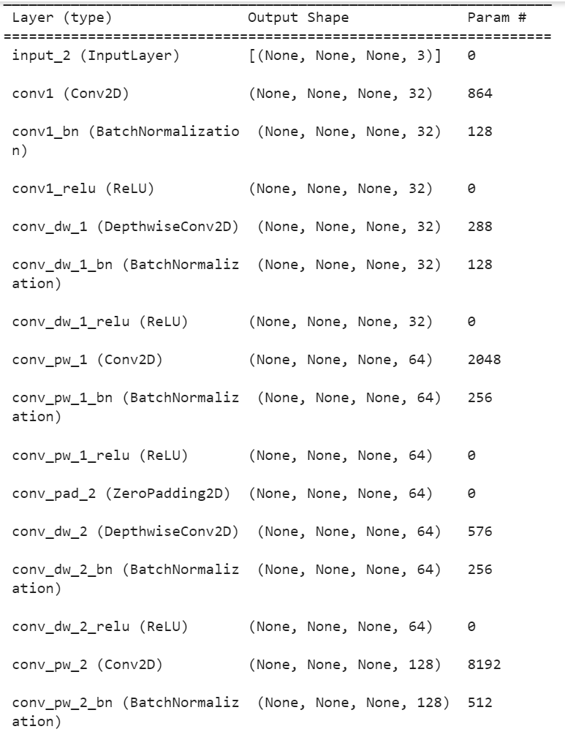
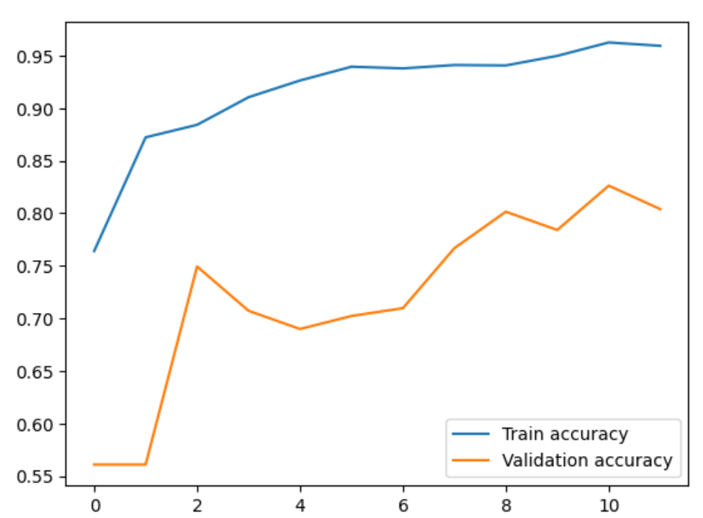
MOBILENET:Model Performance
Train Accuracy : 95.94%
Test Accuracy : 80.40%

Slide 13
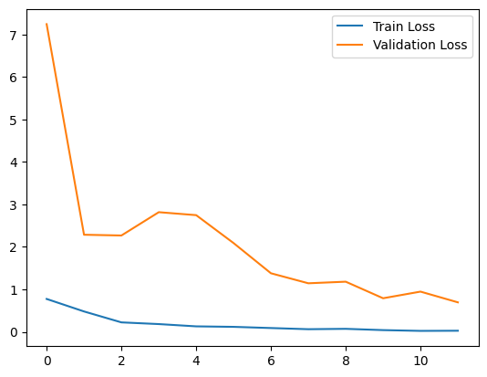
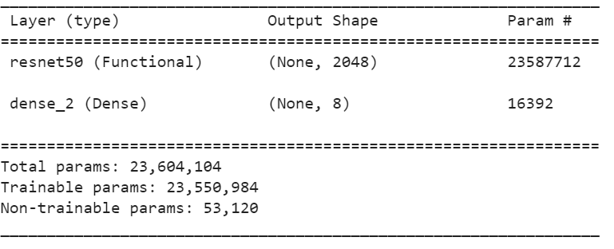
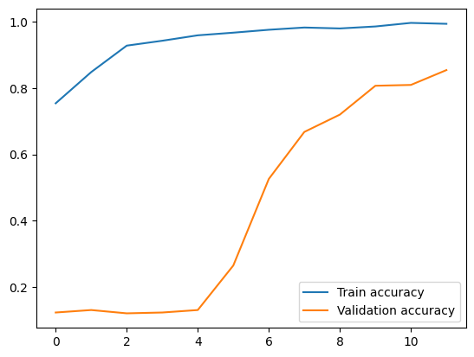
Resnet50: Model Performance
Train Accuracy: 98.97%
Test Accuracy: 81.39%

Slide 14
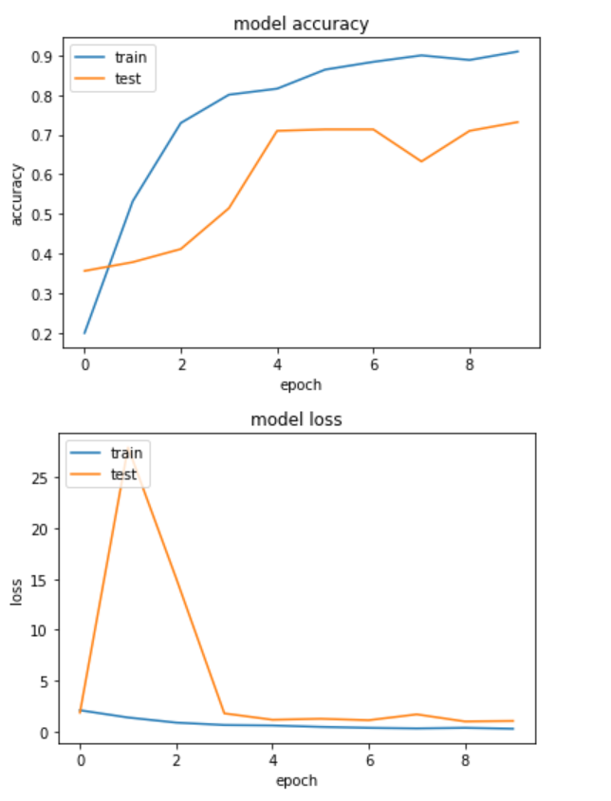
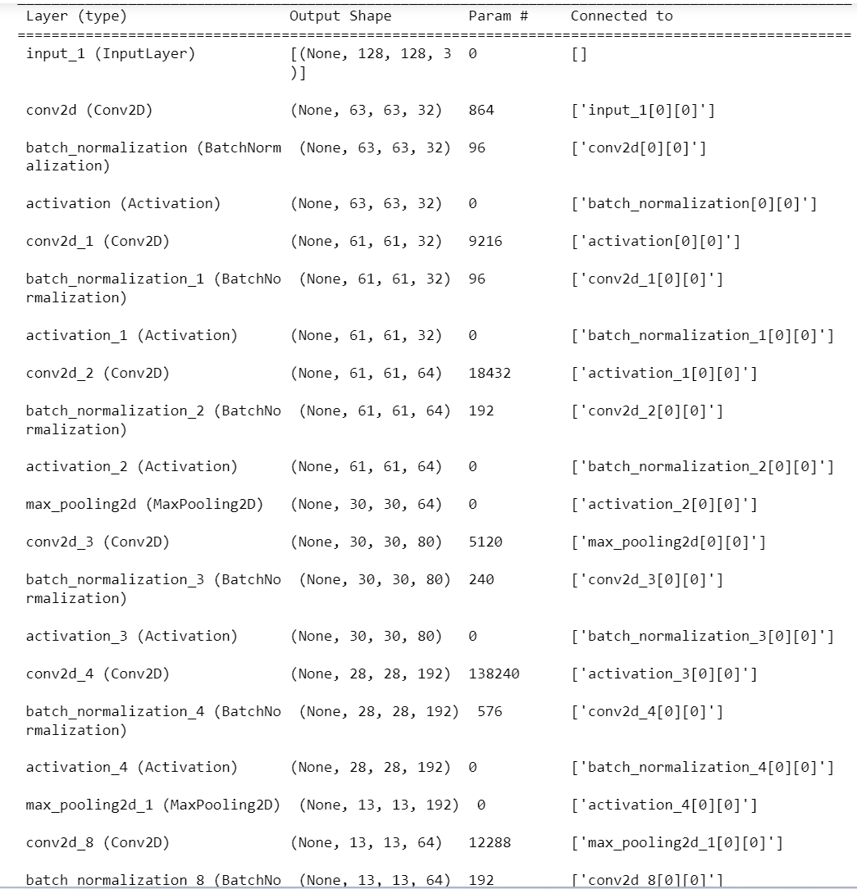
INCEPTIONV3:Model Performance
Train Accuracy : 92.36%
Test Accuracy : 72.79%

Slide 15
Model Comparison
MODEL | TRAIN ACCURACY | TEST ACCURACY | TEST LOSS | EPOCHS
CNN MODEL 1 | 57.10% | 50.12% | 1.4478 | 10
CNN MODEL 2 | 72.22% | 59.80 | 1.3860 | 12
VGG 19 | 88.66% | 77.67% | 0.8177 | 12
RESNET 50 | 98.97% | 81.39% | 0.9111 | 12
MOBILENET | 95.94% | 80.40% | 0.8952 | 12
INCEPTIONV3 | 92.36% | 72.79% | 0.9925 | 10

Slide 16

Champion Model
ResNet50 is the champion

Slide 17
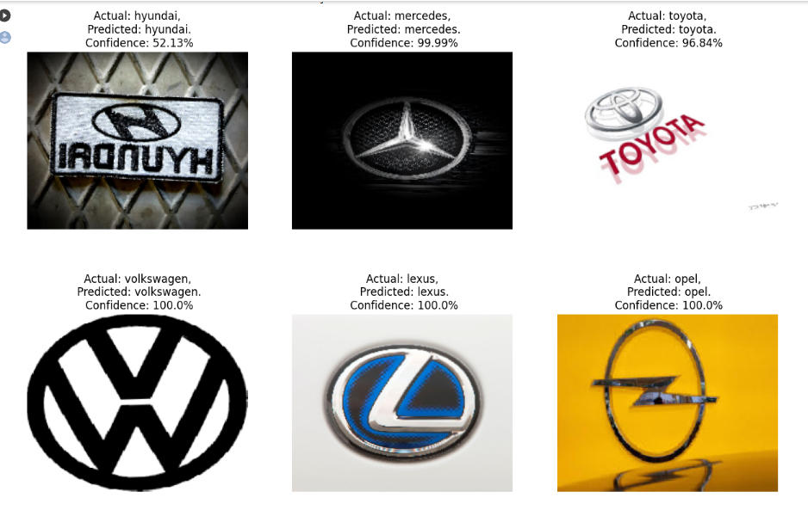
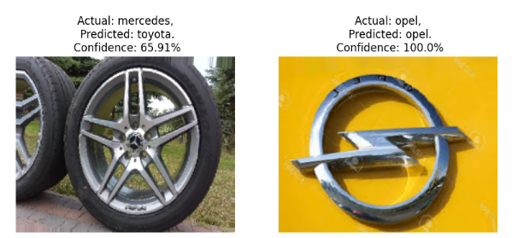
Model Evaluation: Resnet50 Predicted classes

Slide 18
Questions?
Thank you!

